Slide 1
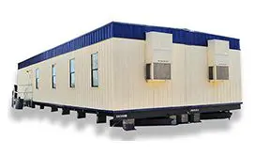
Home | Rent | Buy | Pricing | Blog | About | Quotes
How Much Do Used Construction Trailers Cost in Florida?
Your Complete Pricing Guide for Buying or Renting Mobile Office Trailers
SHOW ME MY OPTIONS
Notes:
Title Tag: How Much Do Used Construction Trailers Cost in Florida?
/Pricing-Guide

Slide 2
While there are a number of factors to consider, renting a used construction trailer in Florida will cost around $175-$300 a month, while purchasing one will cost between $3500-$30,000.
Are you contemplating the acquisition of a used construction trailer in Florida? Whether you are a contractor requiring additional space or a DIY enthusiast, it is crucial to understand the process involved in purchasing a used trailer. This article will provide guidance on various aspects, including the definition of a used construction trailer, factors that influence their costs in Florida, and locations where one can find the most favorable deals. Key considerations prior to making a purchase will be discussed, along with the benefits of acquiring a used trailer, potential risks involved, and recommendations for ensuring a smooth transaction. Continue reading to make an informed decision that aligns with your needs and budget.

Slide 3
From Pensacola to Fort Lauderdale
How to Calculate Used Construct-on Trailers Cost in Florida
MOBILE OFFICES | CLASS ROOM TRAILERS | PORTABLE OFFICE BUILDINGS | JOB SITE OFFICE TRAILERS
I’M READY FOR QUOTES
The cost of a used construction trailer in Florida can vary significantly based on several factors, including the type, size, and condition of the trailer, as well as the decision to rent or purchase. In general, the used trailer market offers affordable options for office trailers, with prices typically lower than those for new office trailers.
It is essential to understand the rental costs associated with these trailers to make informed decisions, particularly for those with short-term needs or long-term needs.
Notes:
SENIDNG YOU NEW ICONS WITH Branded colors.

Slide 4
Popular Sizes
Solutions
8’ x 20’: 200 sq. feet
8’ x 28’: 350 sq. feet
8’ x 32’: 400 sq. feet
10’ x 36’: 450 sq. feet
10’ x 44’: 500 sq. feet
12’ x 44′: 700 sq. feet
12’ x 56’: 800 sq. feet
12’ x 64’: 1,000 sq. feet
24’ x 56’: 1,400 sq. feet
And More
Temporary Office Space
Portable Office Buildings
Construction Site Offices
Modular Office Trailers
Job Site Office trailers
Office Trailer Rental
Prefabricated Office Units
Climate-Controlled Office Trailers
Office Trailer Leasing Options
Used Office Trailers For Sale
Factors That Affect the Cost of a Used Construction Trailer in Florida
When assessing the cost of a used construction trailer in Florida, it is essential to consider several key factors that can vary significantly based on location, specific features, and overall condition. A comprehensive understanding of these elements is critical for making an informed decision. The size of the trailer is a significant consideration, as larger models typically incur higher costs. Additionally, the condition of the trailer—whether it is a used model or a new office trailer—can greatly influence pricing. Customization options and features tailored to specific business needs can further increase the overall expense, along with potential delivery fees associated with transporting the trailer.
Factors influencing the cost of used construction trailers include:
Size: The dimensions of the trailer are instrumental in determining the price. Larger trailers that can accommodate more equipment or personnel generally come at a higher cost.
Condition: A well-maintained used trailer may command a higher price than one that exhibits signs of wear and tear. Buyers should evaluate whether they prefer a refurbished option.
Customization: Modifying a trailer to meet particular business requirements—such as additional electrical outlets or enhanced insulation—can increase costs, especially if specialized features are necessary.
Delivery Fees: These costs can vary depending on the distance from the seller to the buyer's location, adding another expense to the initial purchase price.

Slide 5
GETTING START IS EASY AS 1,2,3
1-TELL US WHEN AND WHERE
Briefly, tell us when you need your mobile office and where you need it delivered.
2-GET QUOTES
Get amazing quotes only from local dealers near you.
3-DECIDE
Pick the product that best fits your needs. Your Done!
Get Your Quote Today!
Don’t waste time searching for overpriced alternatives. Get the best used construction trailers in Florida—delivered fast, at unbeatable prices. Request a free quote online to secure your trailer today!
Notes:
SENIDNG YOU NEW ICONS WITH Branded colors.

Slide 6
Where Can You Find Used Construction Trailers in Florida?
TEMPORARY OFFICE SPACE | MODULAR OFFICE TRAILERS| MOBILE OFFICE CONTAINERS| PRFABRICATED OFFICES
SHOW ME PRICES
If one is located in Orlando, FL, and seeks to acquire used construction trailers, there are several avenues to consider that can effectively provide access to affordable solutions. Online marketplaces have emerged as a prevalent option for locating used office trailers, offering a diverse range of choices for potential buyers.
Furthermore, local classifieds and auctions frequently include listings for used trailers, presenting opportunities for direct price negotiations with sellers. Each of these channels offers the potential for considerable savings, particularly for those who remain attentive to rental costs and available options.

Slide 7
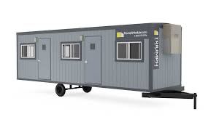
Online Marketplaces
Online marketplaces have emerged as a primary resource for individuals seeking to purchase used office trailers in Florida, providing a diverse array of buying options that cater to various requirements. Websites specializing in construction supplies typically feature dedicated sections for mobile offices and portable buildings, thereby facilitating price and feature comparisons. This approach enables prospective buyers to examine multiple listings from the comfort of their homes, assisting them in making informed decisions regarding their temporary office space needs.
Along with the convenience offered, online platforms foster connections with reputable sellers, thereby enhancing trust in transactions.
Among the prominent websites are Craigslist, eBay, and specialized construction supply hubs, which list both new and used options.
Buyers have the ability to filter searches by condition, size, and price range, allowing them to identify the most suitable trailer for their project.
It is also common for sellers to provide details about previous usage and any modifications made, offering potential buyers comprehensive insights.
Utilizing these online marketplaces can result in significant cost savings, as many listings feature competitive prices that are not always accessible through traditional dealerships. Consequently, it is advisable for buyers to routinely monitor these platforms to discover the best deals and selections available in the market.

Slide 8
Local Classifieds
Local classifieds represent a viable option for locating used trailers in Orlando, FL, offering community listings that may not be accessible on larger online platforms. These local resources frequently feature sellers eager to quickly sell their used office trailers at competitive prices, potentially leading to more favorable deals for buyers. By regularly consulting local newspapers, community boards, and specialized websites, individuals can discover hidden opportunities that fulfill their temporary office space requirements.
Engaging with local classifieds not only promotes a sense of community but also facilitates personalized transactions. Buyers have the opportunity to interact directly with sellers, enabling them to pose questions, negotiate prices, and inspect the trailers in person prior to finalizing a purchase. This face-to-face interaction fosters a better understanding and trust, often culminating in a smoother buying process.
Furthermore, sellers who utilize local classifieds typically possess a strong incentive to price their items competitively, as they aim for quick sales rather than prolonged listings. Consequently, this environment can be advantageous for buyers seeking cost-effective solutions.
Access to exclusive local listings
Opportunity to negotiate directly with sellers
Potential savings through competitive pricing
By exploring these platforms, individuals may find the ideal trailer that meets their budget and preferences while concurrently supporting local sellers.

Slide 9
Auctions
Participating in auctions can serve as an effective method for acquiring used trailers at reduced prices, particularly in Florida, where numerous auctions cater to construction and real estate requirements. Bidding on office trailers can yield substantial savings, as items are typically sold to the highest bidder. Auctions offer a transparent environment, allowing buyers to assess the condition of the trailers prior to placing bids, thereby establishing a reliable avenue for acquiring quality used office trailers.
To fully appreciate how auctions function, it is essential to understand the bidding mechanisms involved, which can significantly enhance the overall experience and ensure a sound investment. Many participants discover that the thrill of bidding not only results in competitive pricing but also cultivates a sense of community among buyers.
The following points outline the key benefits of participating in auctions:
Cost-Effectiveness: Used trailers are often available at prices below market value, primarily due to the competitive nature of the bidding process.
Transparency: Auctions typically permit prospective buyers to inspect the condition of each office trailer, providing reassurance regarding the quality of their purchase.
Diverse Selection: Auctions frequently showcase a wide range of used trailers, accommodating various needs and budgets, thus offering buyers an expanded array of choices.
In summary, engaging in the dynamic environment of auctions can represent a prudent decision for individuals seeking office trailer sales and effective strategies for securing used trailers.

Slide 10
Shop From Over 40,000 Mobile Offices Trailers
Temporary Office Space For Any Budget
PRE-OWNED CONSTRUCTION TRAILERS| PORTABLE OFFICE CONTAINERS| MOBILE JOBISTE OFFICES
I’M READY FOR QUOTES

Slide 11
Quick & Hassle-Free Delivery Anywhere in Florida
We make securing a job site trailer easy with fast, hassle-free delivery across Florida. Whether you're in Miami, Tampa, St. Petersburg, Orlando, Fort Myers, Gainesville, or anywhere in between, we ensure on-time delivery so you can stay focused on your project.
Popular Areas We Serve:
Jacksonville, FL
Miami, FL
Tampa, FL
Orlando, FL
St. Petersburg, FL
Hialeah, FL
Port St. Lucie, FL
Tallahassee, FL
Cape Coral, FL
Fort Lauderdale, FL
Pembroke Pines, FL
Miramar, FL
Gainesville, FL
Coral Springs, FL
Clearwater, FL
Lehigh Acres, FL

Slide 12
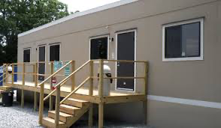
What Should You Consider When Buying a Used Construction Trailer in Florida?
When contemplating the purchase of a used construction trailer in Florida or nearby Orlando FL, it is essential to consider several important factors to ensure that the acquisition aligns with your business requirements effectively.
The condition of the trailer is of utmost importance, as it directly impacts both the initial investment and the ongoing maintenance expenses. Furthermore, assessing the size and specific features necessary for your intended application will aid in determining whether the trailer will adequately fulfill your short-term or long-term needs.
Additionally, it is crucial to consider the logistics of delivery and setup, as these factors can significantly influence the overall usability of the trailer, especially when exploring options to rent office trailers or buy office trailers for your business.

Slide 13
Condition of the Trailer
The condition of a used construction trailer is a critical factor to assess prior to making a purchase, as it significantly impacts both the current value and future maintenance expenses.
Conducting a comprehensive inspection can uncover latent issues such as structural damage or wear that may not be readily apparent. It is advisable for buyers to inquire about the trailer's maintenance history, as those that have been regularly serviced are typically more reliable and economically advantageous over time.
To ensure a prudent investment, prospective buyers should prioritize a thorough inspection process. Key considerations for evaluating the condition of construction trailers include:
Exterior Condition: Examine for rust, dents, and cracks on the body, as these may indicate underlying structural problems.
Interior Assessment: Check for signs of leakage, mold, or water damage that could suggest inadequate seals or significant wear.
Mechanical Components: Test the brakes, lights, and any other mechanical features to verify their proper functioning.
Maintenance Records: Always request documentation of previous maintenance to assess the level of care the trailer has received.
By meticulously evaluating these factors, buyers can make informed decisions that will mitigate future challenges and costs associated with maintenance.

Slide 14
Size and Features
The size of the used construction trailer directly influences its functionality and suitability for specific projects, making it a critical consideration for potential buyers. Different projects may necessitate varying space solutions, whether a compact mobile office or a larger conference room configuration. The required features—such as air conditioning, insulation, or built-in restrooms—can significantly impact the trailer's usability and comfort for temporary office space.
Understanding these nuances enables buyers to make informed decisions. For instance, a small site with a limited workforce may only require a compact unit for administrative tasks, while larger teams engaged in extensive projects could benefit from a more spacious setup that accommodates meetings and staff breaks.
Space: Assess the number of personnel and equipment that will need to fit within the trailer, considering options like the 8×20 Trailer or 12×60 Trailer.
Essential Features: Prioritize functionalities that enhance working conditions and facilitate ease of access.
Customization: Choose units that can be tailored to specific needs, providing the operational support necessary for successful project completion.
By thoroughly evaluating size and features, businesses can ensure they select the most appropriate used office trailers that align with their unique operational requirements.

Slide 15
Delivery and Setup
Considering the logistics of delivery and setup is essential when purchasing a used construction trailer, as these factors can significantly influence both the overall cost and timeline of a project. Buyers should inquire about any additional delivery fees and the logistics associated with positioning the trailer on-site. Proper setup is crucial, particularly for those opting to rent office trailers, as it ensures that the space is functional and ready for immediate use.
Once the decision to acquire a used trailer is made, several factors come into play that can affect both expenses and operational efficiency:
Delivery Costs: Delivery fees can vary considerably based on the distance from the seller to the job site and the specific transportation requirements.
Site Preparation: It is important to evaluate site conditions to ensure that the chosen location is accessible for large vehicles and suitable for the trailer's weight and size.
Setup Procedures: Understanding the setup process is necessary, which may include leveling the trailer, connecting utilities, and ensuring compliance with local regulations.
Neglecting these logistical considerations could result in delays, additional fees, or functional inadequacies in the workspace, making thorough planning critical for any project manager.

Slide 16
Compare Quotes and Save
Consumers Who Got Quotes From Us Save an Average of 24%
USED CONSTRUCTION TRAILERS| MOBILE OFFICE TRAILERS | JOBISTE OFFICES
I’M READY FOR QUOTES

Slide 17
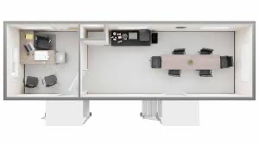
What Are the Benefits of Buying a Used Construction Trailer in Florida?
Acquiring a used construction trailer in Florida presents numerous advantages that can greatly improve business operations and project efficiency.
One of the foremost benefits is the cost savings associated with purchasing used trailers, which typically are available at a significantly lower price than new office trailers, thereby enabling businesses to optimize their budgets.
Furthermore, the diverse selection of trailer types ensures that specific solutions can be identified to meet particular needs, and many used trailers offer customization options to fulfill unique requirements.

Slide 18
Cost Savings
One of the notable advantages of acquiring used trailers is the significant cost savings associated with this option, making it a financially prudent choice for businesses requiring temporary office space.
By opting for used construction trailers, companies can benefit from price advantages that extend beyond the initial purchase. These savings not only alleviate immediate financial pressures but also improve cash flow management, enabling businesses to allocate funds toward equipment upgrades, labor costs, or marketing initiatives.
Used trailers often come equipped with many of the features found in new models, ensuring that companies do not have to compromise on quality for the sake of affordability, thereby making them a viable option for mobile offices and mobile sales offices.
Startups can allocate resources to growth initiatives rather than excessively investing in new assets.
Established firms can enhance overall operational efficiency through strategic budget allocation.
The financial implications of purchasing used trailers can significantly contribute to improving budget management and facilitating successful project execution.

Slide 19
Availability
The availability of used office trailers in Florida offers a distinctive opportunity for businesses seeking flexible space solutions without the extended lead times typically associated with new construction projects. The current market variety ensures that prospective buyers can identify the appropriate trailer to fulfill their specific requirements, whether for short-term projects or long-term utilization. This extensive selection is designed to accommodate a wide range of business needs, from construction sites to temporary medical offices.
Numerous industries benefit from used office trailers, with options available in various sizes, layouts, and configurations tailored for different applications. Businesses can consider:
Standard office setups, which are ideal for administrative tasks.
Multi-room trailers that can accommodate teams requiring collaborative spaces.
Customizable units that provide specific amenities based on industry demands.
This broad array of choices enables companies to effectively tackle their unique operational challenges while also ensuring cost-efficiency in their workspace solutions. The increasingly competitive market fosters flexibility in pricing, making it simpler for businesses to locate an option that aligns with both their budgetary constraints and spatial requirements.

Slide 20
Customization Options
Customization options available with used construction trailers enable businesses to tailor their temporary office spaces to meet specific needs and preferences. Many used trailers are equipped with versatile features, allowing for the addition of partitions for private offices or the enhancement of the trailer with necessary amenities. This flexibility in customization ensures that businesses can create an environment that aligns seamlessly with their operational goals.
Used construction trailers provide a range of flexible solutions that can significantly enhance workspace efficiency. Owners can select from various options, including:
Interior Layout: Adjusting floor plans to maximize space and accommodate teams of different sizes.
Climate Control: Installing heating and cooling systems to ensure comfort throughout the year.
Electrical Upgrades: Modifying electrical setups to support advanced equipment and meeting technologies.
Exterior Options: Customizing the trailer's exterior for branding purposes to ensure it complements the company’s image.
These tailored modifications not only address immediate operational requirements but also contribute to overall productivity, underscoring the value of investing in used construction trailers and portable offices for construction office rentals in Orlando, FL.

Slide 21
Our Team is Standing By TO Get You Quotes from Local Partners
Most people get a respond within 15 minutes
SHOW ME PRICES
Types of Used Construction Trailers
Our suppliers offer a wide range of modular office solutions, available for sale or lease, including:
Mobile office trailers for businesses on the move
Construction site office trailers for on-site project management
Prefabricated office units for permanent or temporary use
Portable office buildings for fast and efficient workspace setup
Temporary office space for seasonal or short-term business needs
Modular office complexes for growing companies that need additional space

Slide 22
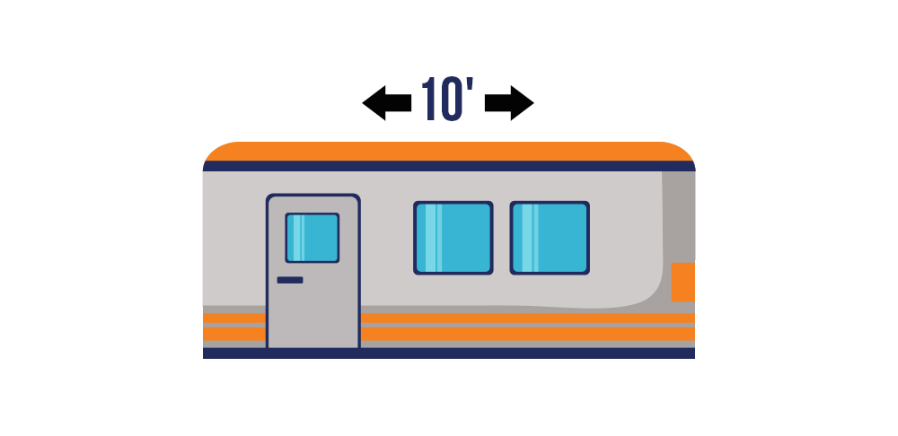
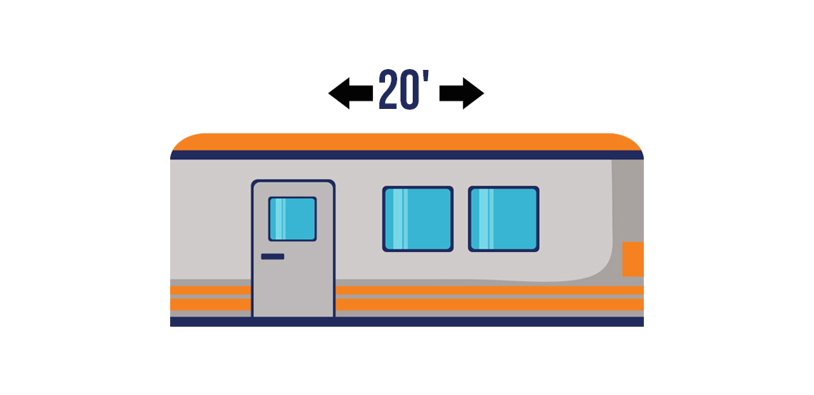
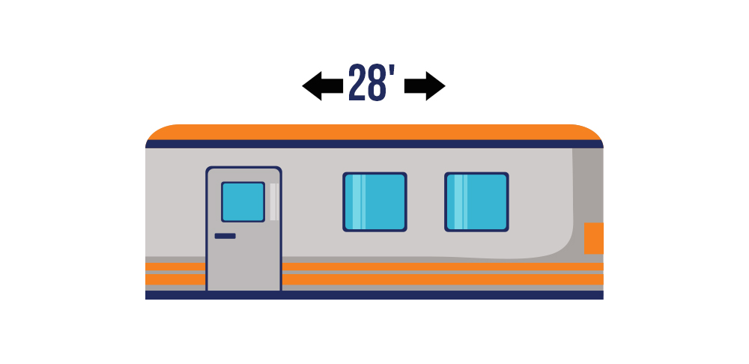
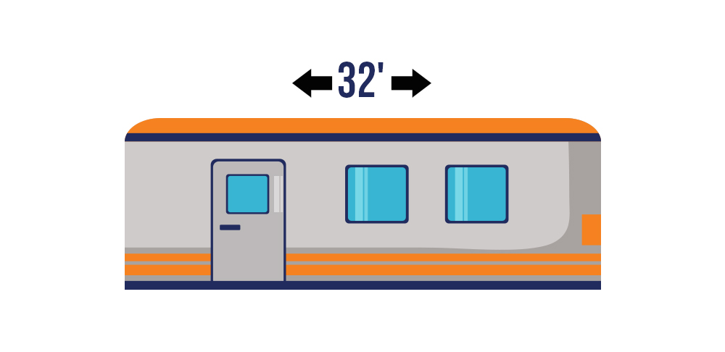
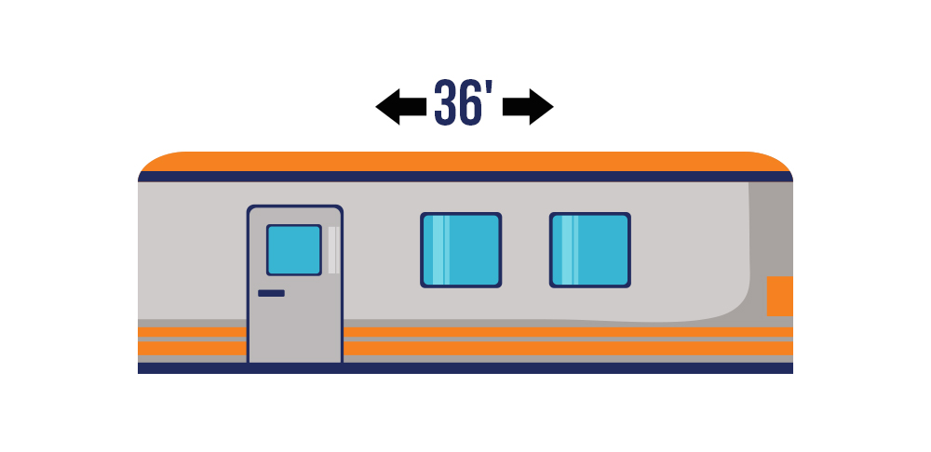
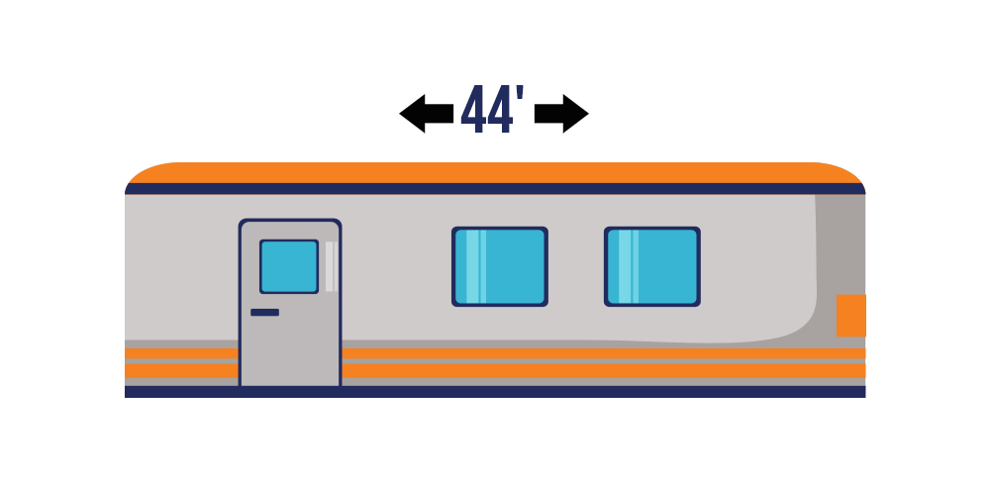
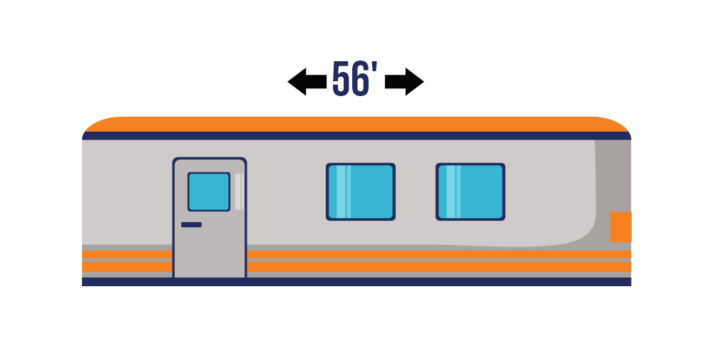
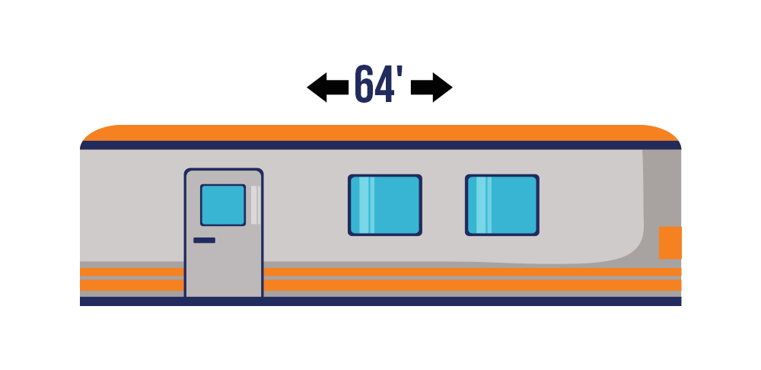
Used Construction Trailers For Sale in Florida
10’ Office Trailer
$3,500-$6,000
20’ Office Trailer
$5,000-$11,000
28’ Office Trailer
$7,000-$20,000
32’ Office Trailer
$12,000-$22,000
GET INFO
GET INFO
GET INFO
GET INFO
36’ Office Trailer
$14,000-$25,000
44’ Office Trailer
$15,000-$26,000
56’ Office Trailer
$16,000-$45,000
64’ Office Trailer
$19,000-$50,000
GET INFO
GET INFO
GET INFO
GET INFO

Slide 23
Used Construction Trailers For Rent in Florida
10’ Office Trailer
$175-$300/Month
20’ Office Trailer
$240-$325/Month
28’ Office Trailer
$250-$375/Month
32’ Office Trailer
$300-$400/month
GET INFO
GET INFO
GET INFO
GET INFO
36’ Office Trailer
$310-$475/Month
44’ Office Trailer
$375-$535/Month
56’ Office Trailer
$500-$700/Month
64’ Office Trailer
$550-$725/Month
GET INFO
GET INFO
GET INFO
GET INFO

Slide 24
What Are the Risks of Buying a Used Construction Trailer in Central Florida?
Purchasing a used construction trailer in Central Florida can present several advantages; however, it is crucial to recognize the potential risks associated with such transactions. Hidden damages or undisclosed issues may not be evident during initial inspections, which could jeopardize your investment and project timelines, particularly in engineering project sites or as a mobile classroom.
Furthermore, used trailers frequently come with limited warranties, potentially leading to significant financial burdens if unexpected maintenance costs emerge post-purchase, especially when considering trailer costs for office trailers for rent or office trailers for sale. Therefore, conducting comprehensive evaluations is essential to mitigate these risks.

Slide 25
Hidden Damage or Issues
One of the most significant risks associated with purchasing used construction trailers is the potential for hidden damage that may not be readily apparent during initial inspections. Such damage can result in costly repairs and may compromise the trailer's functionality, particularly in flexible options like temporary medical offices or public-facing spaces. Therefore, it is essential for buyers to conduct thorough inspections and inquire about the trailer's maintenance history in order to mitigate these risks.
When considering a used construction trailer, the implications of hidden damage cannot be overstated. This unseen wear and tear can worsen over time, leading not only to financial burdens but also to project delays that disrupt timelines. Consequently, prospective buyers should focus on the following:
Comprehensive Inspections: Engaging a professional inspector who specializes in construction trailers can provide insights that may be overlooked by an untrained eye.
Maintenance Records: Requesting detailed records of past services and repairs can reveal a history of significant issues and the methods employed to address them.
Documentation of Upgrades: Understanding any updates or modifications made to the trailer can assist in evaluating its current condition and suitability for the intended use.
By taking these thorough steps, buyers will gain a clearer understanding of potential hidden damage, enabling more informed purchasing decisions.

Slide 26
Limited Warranty
The limited warranty associated with many used office trailers presents a significant risk for buyers, as it often offers minimal protection against defects and issues that may arise post-purchase.
In contrast to new office trailers, which typically come with comprehensive warranties, used options may expose buyers to unexpected repair costs, necessitating a careful risk assessment prior to finalizing the purchase. Buyer protection is a critical consideration, as it greatly influences the long-term viability of the investment.
Prospective buyers should conduct thorough due diligence when reviewing warranty terms, as gaps in coverage may result in unforeseen financial burdens. It is advisable to request detailed information regarding the trailer's prior usage and any existing issues. Additionally, buyers may want to consider hiring a professional inspector to evaluate the current condition of the trailer.
By taking a proactive and informed approach, individuals can effectively navigate the complexities of purchasing a used office trailer, ultimately safeguarding their interests.

Slide 27
Potential for Higher Maintenance Costs
One of the challenges associated with purchasing used trailers is the potential for increased maintenance costs that may arise due to wear and tear over time. These costs can accumulate rapidly and significantly impact the overall investment, making it essential to consider the long-term implications of acquiring a used construction trailer or office trailers. Evaluating the anticipated maintenance requirements should form an integral part of the budgeting process when planning such a purchase, particularly for modular buildings or portable buildings.
When addressing budget considerations for used construction trailers, it is crucial to anticipate the necessary repairs and upgrades that may become required as the trailer ages. Given that these trailers often endure harsh working conditions, they may necessitate more frequent inspections and replacements of critical components, including mobile offices like:
Brakes and suspension systems
Electrical wiring and lighting fixtures
Structural inspections and repairs
Investing in a comprehensive inspection prior to the purchase can help identify any existing issues; however, ongoing maintenance should also be factored into the budget to ensure that the trailer remains functional and compliant with applicable regulations. By proactively planning for these expenses, one can mitigate financial strain and effectively manage the total cost of ownership throughout the duration of the trailer's use.

Slide 28
How Can You Ensure a Smooth Transaction When Buying a Used Construction Trailer in Florida?
Ensuring a seamless transaction when purchasing a used construction trailer in Central Florida requires the implementation of several key steps that can significantly mitigate risks and enhance the overall buying experience, whether you're considering a modular fire station or a modular office building.
It is imperative to conduct a thorough inspection of the trailer to evaluate its condition and suitability for the intended use, as this critical step aids in identifying any potential issues at an early stage.
Furthermore, acquiring the appropriate documentation from the seller, including maintenance records and ownership history, is essential for verifying the legitimacy of the trailer and facilitating effective price negotiation.

Slide 29
Thoroughly Inspect the Trailer
A thorough inspection of the used trailer is essential during the purchasing process, as it enables prospective buyers to evaluate the condition and identify any issues that may impact usability, especially for office trailer costs. This assessment should encompass an examination of structural integrity, verification that all features required are operational, and scrutiny for signs of hidden damage.
By performing a comprehensive inspection, buyers can significantly mitigate the risk of encountering unexpected problems post-purchase. It is crucial to concentrate on specific areas during the evaluation process:
Condition Assessment: Examine the frame for rust, corrosion, and cracks.
Brakes and Tires: Check for even wear and ensure proper inflation.
Electrical Systems: Test all lights and wiring for functionality.
Hitch: Confirm that the coupling components are secure and intact.
Interior: Investigate for any signs of water damage, mold, or stains that may indicate leaks.
Through this detailed evaluation, buyers enhance their understanding of the trailer's value and longevity, ultimately leading to a more informed purchasing decision.

Slide 30
Ask for Documentation
Requesting documentation is an essential step in ensuring a transparent and secure transaction when purchasing a used construction trailer or lease office trailers for extra space.
By obtaining comprehensive records, individuals can significantly mitigate the likelihood of encountering unexpected issues after the purchase. Buyers should specifically request maintenance logs to obtain evidence of the trailer's care and upkeep throughout its lifetime. Reviewing the ownership history can reveal any potential accidents or repairs that may have compromised the trailer’s structural integrity.
Additionally, it is prudent to inquire about any warranties or service agreements that may still be in effect, as these can provide valuable purchase assurance. Acquiring such documentation is ultimately an invaluable measure in making an informed investment.

Slide 31
Negotiate the Price
Negotiating the price of a used construction trailer can have a significant impact on overall expenditure and should be approached strategically to ensure value for money, especially when considering multi-functional office setups like a 12×60 trailer or 24′ x 60′ modular office.
Prospective buyers are encouraged to conduct comprehensive research on comparable trailer prices and evaluate value based on the condition and features required, such as in financial banking settings or other public-facing spaces. This process includes understanding market trends in their locality and assessing the specifications of various models to determine the best fit for their needs.
Additionally, buyers may consider the following strategies:
Utilize online marketplaces and local classifieds for price comparisons.
Conduct a thorough inspection of the trailer to identify any potential repairs needed.
Evaluate the seller's urgency to sell, which can provide leverage during negotiations.
The effective application of these strategies can enhance buyers' negotiating power and lead to more favorable outcomes, ultimately resulting in a better deal without compromising on essential specifications or quality.

Slide 32
Ready to Get a Great Price on Construction Trailer Offices
Let’s Work Together
GET ME LOCAL PRICES

